Slide 1

Analytics
Unit V

Slide 2
Course Content
Unit V
Image Processing
Analytics
Facebook
Twitter
Web Programming
Flask
DJango

Slide 3
Image Processing
Computer Vision
Digital
Enhance Image
Smoothening
Sharpening
Contrast
Stretch
Restoration

Slide 4
Applications
Original Image
Zoom
Blur
Sharp
Edges

Slide 5
Medical
Gamma Ray
PET Scan
X-Ray
CT Scan
UV Imaging

Slide 6
AI
Object Detection
Line Follower
Face Recognition
Face Identification

Slide 7
Other Applications
Color
Pattern
Video

Slide 8
Image Processing Python Libraries
Open CV
4.5.2
Numpy
1.20.0
Scipy
PIL
Matplotlib
1.6.3
8.2.0
3.4.1

Slide 9
GrayScale
import cv2
image = cv2.imread('sist.jpg')
cv2.imshow('Original', image)
cv2.waitKey()
gray_image = cv2.cvtColor(image, cv2.COLOR_BGR2GRAY)
cv2.imshow('Grayscale', gray_image)
cv2.waitKey(0)
cv2.destroyAllWindows()

Slide 10
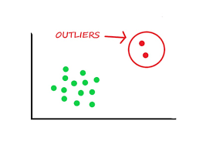
Image Blur
Remove outlier pixels in the image

Slide 11
Approaches
Averaging
Gaussian Blurring
Median Blurring
Bilateral Filtering

Slide 12
Image Blurring
import cv2
img = cv2.imread('sist.jpg')

Slide 13
Averaging Approach
avging = cv2.blur(img,(10,10))
cv2.imshow('Averaging',avging)
cv2.waitKey(0)

Slide 14
Gaussian Approach
gausBlur = cv2.GaussianBlur(img, (5,5),0)
cv2.imshow('Gaussian Blurring', gausBlur)
cv2.waitKey(0)

Slide 15
Median Blurring
medBlur = cv2.medianBlur(img,5)
cv2.imshow('Median Blurring', medBlur)
cv2.waitKey(0)
medBlur = cv2.medianBlur(img,9)
cv2.imshow('Media Blurring', medBlur)
cv2.waitKey(0)

Slide 16
Bilateral Filtering
bilFilter = cv2.bilateralFilter(img,9,75,75)
cv2.imshow('Bilateral Filtering', bilFilter)
cv2.waitKey(0)

Slide 17
Histogram
Intensity Distribution of an image
Plot with pixel values (0 to 255)

Slide 18
Histogram Implementation
import cv2
from matplotlib import pyplot as plt
img = cv2.imread('sathyabama.jpg',0)
histr = cv2.calcHist([img],[0],None,[256],[0,256])
plt.plot(histr)
plt.show()

Slide 19
Edge Detection
Image Processing Technique
To find the boundary of objects within images
By detecting discontinuities in brightness
Approach – Canny Edge Detector

Slide 20
Edge Detection - Image
import cv2
import matplotlib.pyplot as plt
image = cv2.imread("sist.jpg")
gray = cv2.cvtColor(image, cv2.COLOR_BGR2GRAY)
plt.imshow(gray, cmap="gray")
plt.show()
edges = cv2.Canny(gray, threshold1=30, threshold2=100)
plt.imshow(edges, cmap="gray")
plt.show()

Slide 21
Edge Detection – Live Cam
import cv2
cap = cv2.VideoCapture(0)
while True:
_, frame = cap.read()
gray = cv2.cvtColor(frame, cv2.COLOR_BGR2GRAY)
edges = cv2.Canny(gray, 30, 100)
cv2.imshow("edges", edges)
cv2.imshow("gray", gray)
if cv2.waitKey(1) == ord("q"):
break
cap.release()
cv2.destroyAllWindows()

Slide 22
Analysis
Statistical Approach
Machine Learning Algorithm
Artificial Intelligence
Deep Learning Technique

Slide 23


Analysis

Slide 24
Types of Analysis
Exploratory
Data and Figure
Noteworthy
Point of Interest
Explanatory
Pearls from Oysters
Specific
Highlight the importance
Correlation
Data Distribution

Slide 25
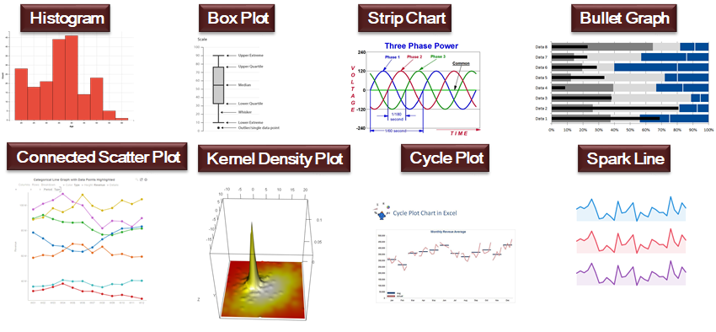
Exploratory Data Analysis

Slide 26
Text Analysis (Natural Language Processing - NLP)
Facebook
Twitter
Whatsapp
Telegram
Feedback / Comments

Slide 27
Facebook
https://www.facebook.com
https://developers.facebook.com/apps
https://developers.facebook.com/tools/explorer

Slide 28
Facebook and Python
pip install facebook-sdk
from facebook import GraphAPI
my_access_token = “……”

Slide 29
from facebook import GraphAPI
my_access_token = “ACCESS CODE OF THE FACEBOOK APP"
graph = GraphAPI(access_token = my_access_token)
print(graph)
profile = graph.get_object('me',fields='id, first_name, posts{message, name, id},likes')
print(profile)
posts = graph.get_connections(profile['id'], 'posts', limit=10)
print(posts)
likes = graph.get_connections(profile['id'], 'likes', limit=10)
print(likes)

Slide 30
Iterate through likes
for like in likes:
for d in likes[like]:
if type(d) is dict:
print()
for x in d:
print(d[x], end=" ")

Slide 31
Write to JSON
import json
with open("facebook.json","w") as of:
json.dump(likes["data"], of, indent=4)

Slide 32
Write to MongoDB
import pymongo
myclient = pymongo.MongoClient("mongodb://localhost:27017")
mydb = myclient["fbdemo"]
mycol = mydb["fbcol"]
for like in likes:
for d in likes[like]:
if type(d) is dict:
mycol.insert_one(d)
myclient.close()

Slide 33
Twitter
https://www.twitter.com
https://developer.twitter.com/
pip install TwitterAPI

Slide 34
Keys (OAuth)
Open Authorization Framework
1.0
2.0
API Key
API Key Secret
Access Token
Access Token Secret
Bearer Token

Slide 35
Twitter & Python
# -*- coding: utf8 -*-
from TwitterAPI import TwitterAPI
SEARCH_TERM = ['#bigdata', '#AI', '#datascience', '#machinelearning', '#ml', '#iot']
CONSUMER_KEY = "YOUR CONSUMER KEY"
CONSUMER_SECRET = "YOUR CONSUMER SECRET KEY"
ACCESS_TOKEN = "YOUR APP ACCESS TOKEN"
ACCESS_TOKEN_SECRET ="YOUR APP ACCESS TOKEN SECRET"
api = TwitterAPI(CONSUMER_KEY, CONSUMER_SECRET, ACCESS_TOKEN, ACCESS_TOKEN_SECRET)
r = api.request('search/tweets', {'q': SEARCH_TERM})
for item in r:
print(item['text'] if 'text' in item else item)

Slide 36
Twitter to MongoDB
import pymongo
myclient = pymongo.MongoClient("mongodb://localhost:27017")
mydb = myclient["twitterdemo"]
mycol = mydb["twittercol"]
for item in r:
mycol.insert_one(item)

Slide 37
Web Programming using Python
Flask
Django

Slide 38
Flask
Flask is a small and lightweight Python web framework that provides useful tools and features that make creating web applications in Python easier.
It gives developers flexibility and is a more accessible framework for new developers since you can build a web application quickly using only a single Python file.
Flask uses the Jinja template engine to dynamically build HTML pages using familiar Python concepts such as variables, loops, lists, and so on.

Slide 39
What is Web Framework?
Web Application Framework or simply Web Framework represents a collection of libraries and modules that enables a web application developer to write applications without having to bother about low-level details such as protocols, thread management etc.

Slide 40
What is Flask?
Flask is a web application framework written in Python.
is developed by Armin Ronacher, who leads an international group of Python enthusiasts named Pocco.
Flask is based on the Werkzeug WSGI toolkit and Jinja2 template engine. Both are Pocco projects.

Slide 41
WSGI?
Web Server Gateway Interface (WSGI) has been adopted as a standard for Python web application development.
WSGI is a specification for a universal interface between the web server and the web applications.
It is a WSGI toolkit, which implements requests, response objects, and other utility functions.
This enables building a web framework on top of it.

Slide 42
Jinja2
Jinja2 is a popular templating engine for Python.
A web templating system combines a template with a certain data source to render dynamic web pages.
Flask is often referred to as a micro framework.
It aims to keep the core of an application simple yet extensible.
Flask does not have built-in abstraction layer for database handling, nor does it have form a validation support.
Instead, Flask supports the extensions to add such functionality to the application.

Slide 43
Install virtualenv for development environment
virtualenv is a virtual Python environment builder.
It helps a user to create multiple Python environments side-by-side.
Thereby, it can avoid compatibility issues between the different versions of the libraries.
The following command installs virtualenv
Pip install virtualenv

Slide 44
Once installed, new virtual environment is created in a folder.
Mkdir newproj
Cd newproj
Virtualenv venv
Activate command
Venv\scripts\activate

Slide 45
To install Flask
Pip install flask

Slide 46
Simple Web App
from flask import Flask
app = Flask(__name__)
@app.route("/")
def hello():
return "Hello World!"
if __name__ == "__main__":
app.run()
pip install flask
localhost:5000

Slide 47
Flask – Routing
Modern web frameworks use the routing technique to help a user remember application URLs.
It is useful to access the desired page directly without having to navigate from the home page.
The route() decorator in Flask is used to bind URL to a function.

Slide 48
Flask – URL Building
The url_for() function is very useful for dynamically building a URL for a specific function.
The function accepts the name of a function as first argument, and one or more keyword arguments, each corresponding to the variable part of URL.

Slide 49
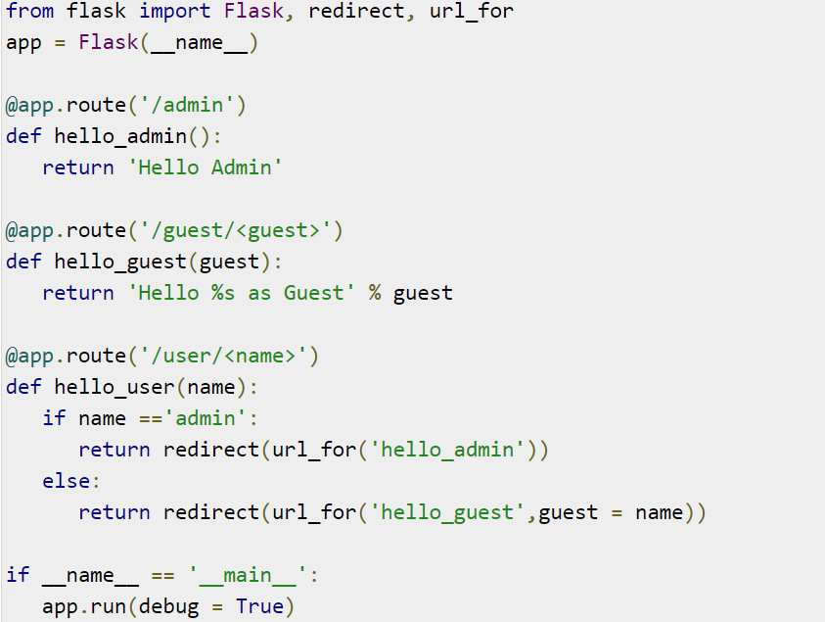
Example

Slide 50
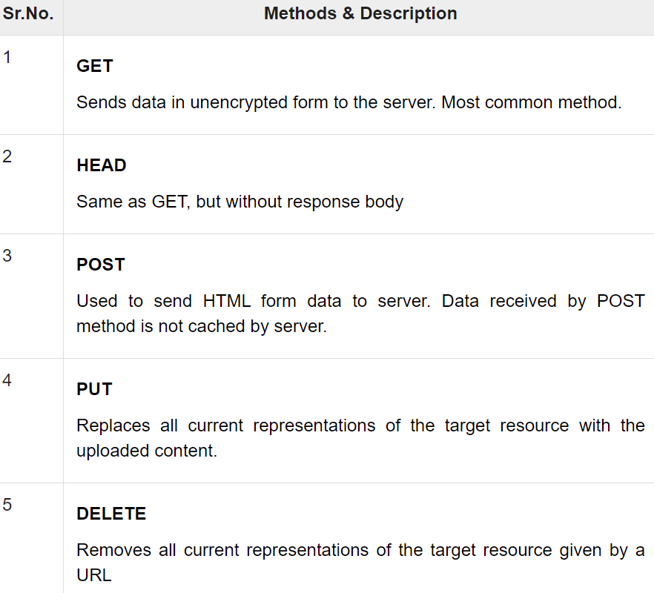
Flask – HTTP methods
Http protocol is the foundation of data communication in world wide web. Different methods of data retrieval from specified URL are defined in this protocol.

Slide 51
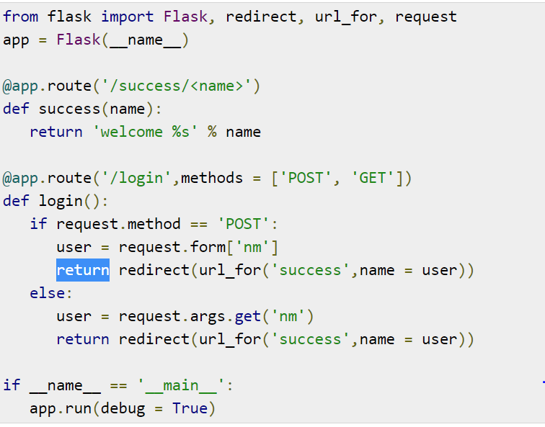
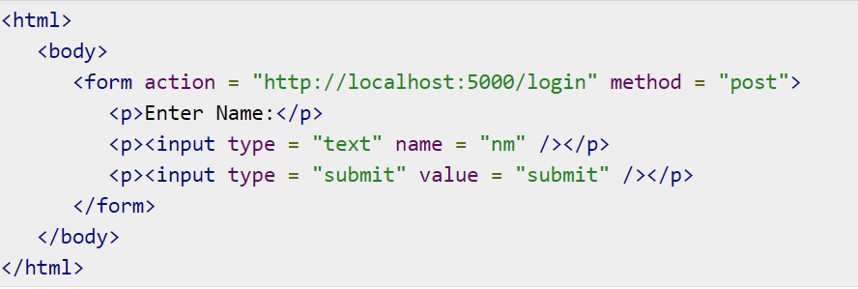
POST()
In order to demonstrate the use of POST method in URL routing, first let us create an HTML form and use the POST method to send form data to a URL.

Slide 52
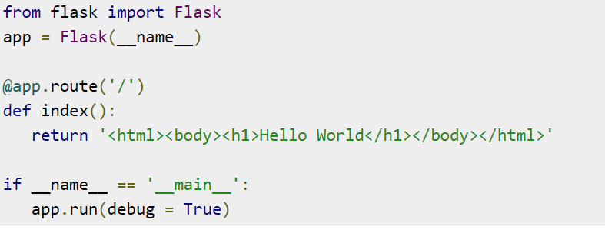


Flask – Templates
It is possible to return the output of a function bound to a certain URL in the form of HTML. For instance, in the following script, hello() function will render ‘Hello World’ with <h1> tag attached to it.

Slide 53
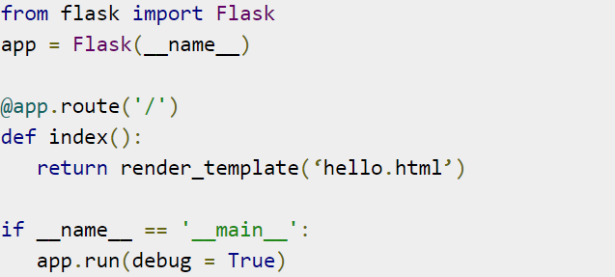
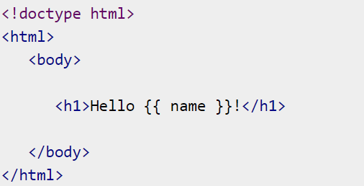
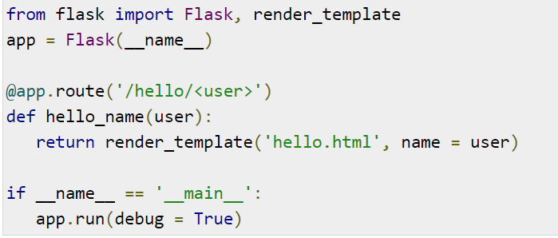
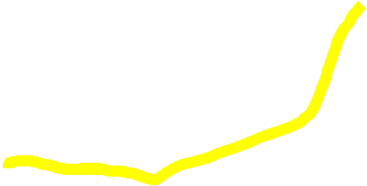



render_template() function.

Slide 54


The jinja2 template engine uses the following delimiters for escaping from HTML:
{% ... %} for conditional Statements
{{ ... }} for Expressions to print to the template output
{# ... #} for Comments not included in the template output
# ... ## for Line Statements

Slide 55
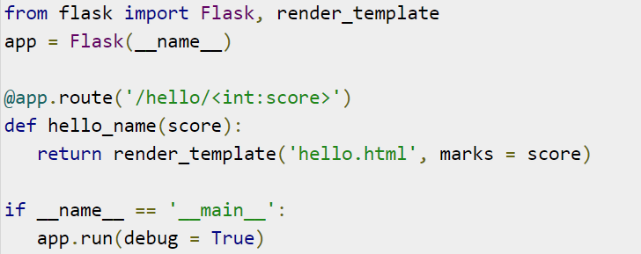
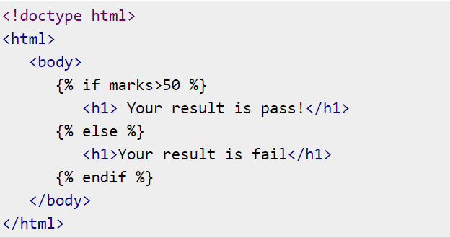
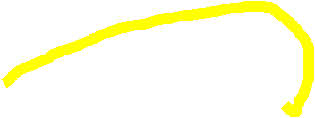


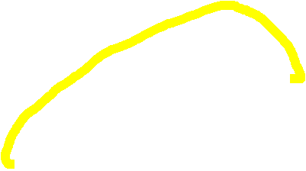








{% ... %} for Statements Example:

Slide 56
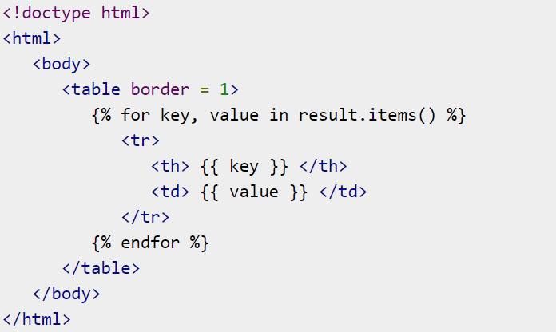
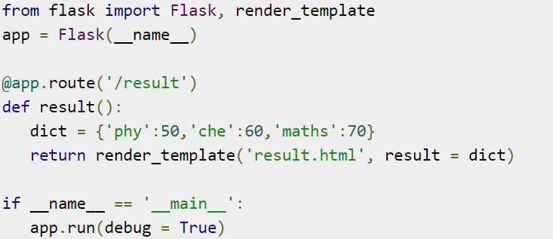











{{ ... }} for Expressions to print to the template output

Slide 57
Flask vs Django
Flask | Django
Created in 2010 | Created in 2005
Flask is WSGI framework. | Django is a Full Stack Web Framework.
Flask provides support for API. | Django doesn't have any support for API.
Support Visual Debug. | No support for Visual Debug.
Flask allows you to use multiple types of databases. | Django doesn't offer multiple types of databases.
The structure of the project layout for Flask web framework is random. | The structure of the project layout for the Django is conventional.
Famous companies using Flask are: Netflix, Reddit, Lyft, MIT | Famous companies using Django are Instagram, Coursera, Udemy.

